Slide 1

MULTI APPS. (PROJECT)

Slide 2
What is Multi App?
This refers to the one app that has built in features of many apps
It now has the following features : 1) Calculator, 2) Binary – Decimal Converter, 3) Covid-19 Tracker, 4) Morse Code Converter, 5) Cryptography (Encryption – Decryption).

Slide 3
Why This App?
As we know we need to install apps for every feature we need, so why not a single app which contain functionality of many (Merged into one).
So the idea behind to choose this project that all apps under one roof will take less space and memory than all apps separately.
In future we can add as many apps features into this as we need.

Slide 4
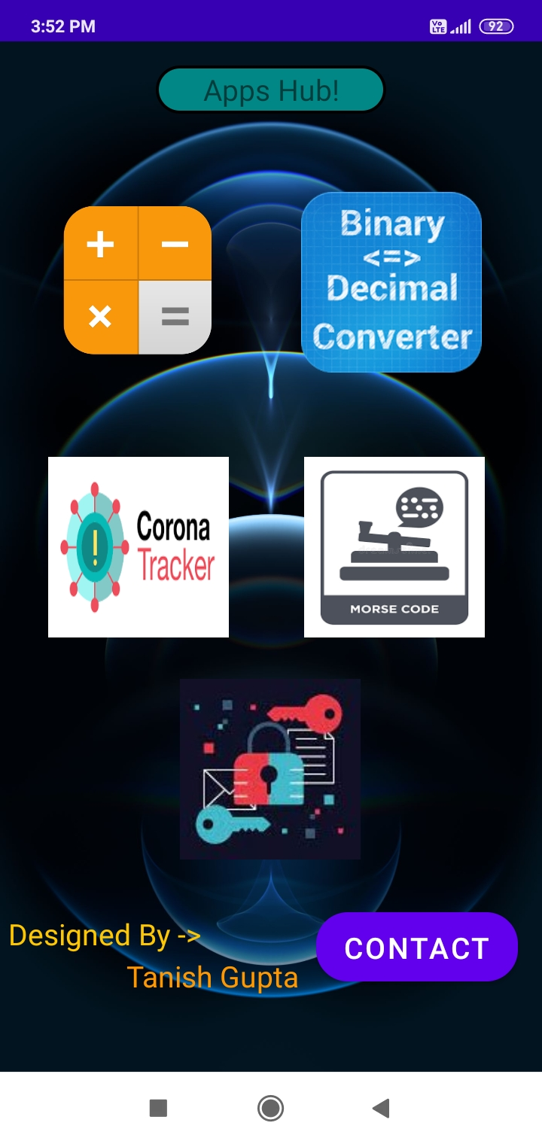
Main Page / Activity
-> This is the starting page of our application, which is the home page.
In this the user choose which feature he/she want to use, Can select from the given option / features.

Slide 5
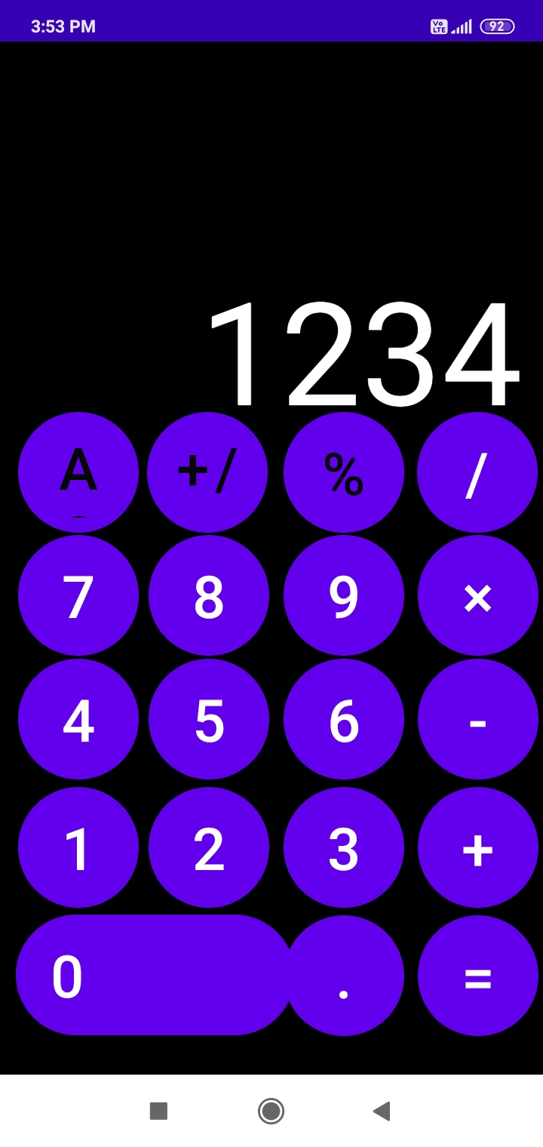
Calculator Activity
-> In this user have all the feature what a calculator have example: Addition, Subtraction, Multiplication, Division and many more.

Slide 6
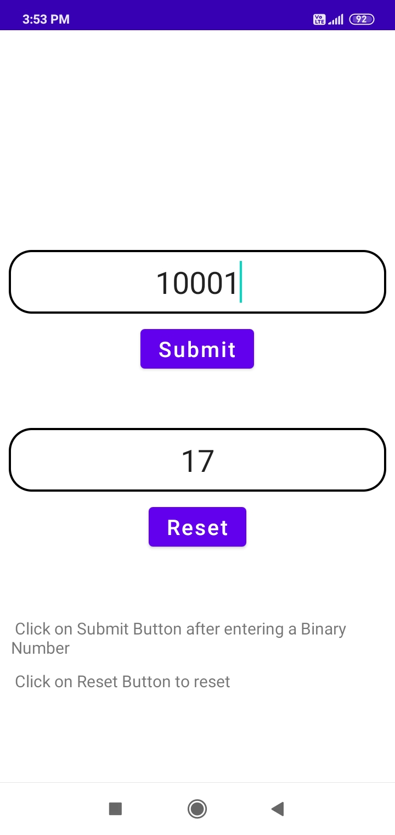
Binary - Decimal Converter Activity
-> This activity have the feature that makes user enter the binary digit and get result as its decimal equivalent.
Submit Button: To submit the binary digit.
Reset Button: To reset all the values given/ taken.

Slide 7
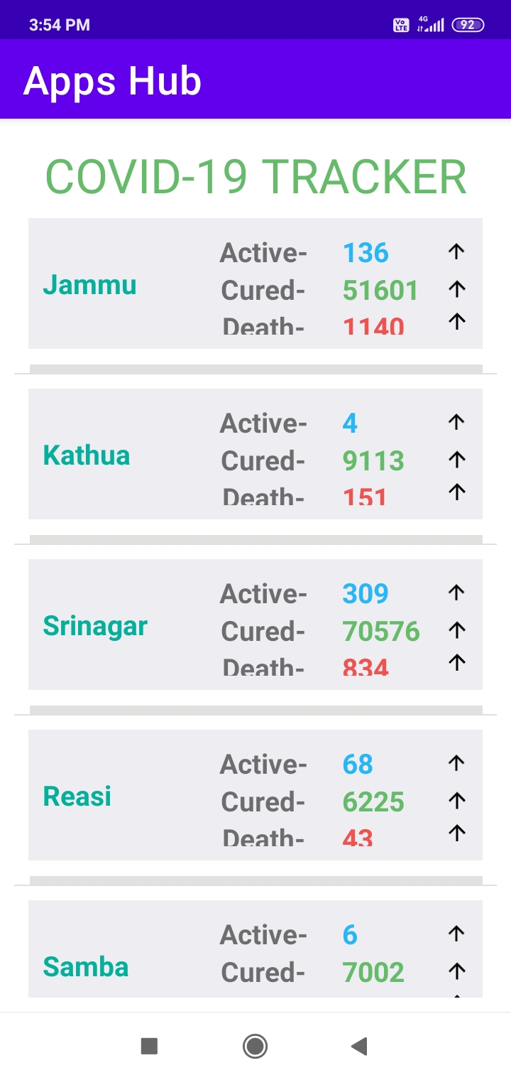
Covid-19 Tracker Activity
-> This activity need Internet permission as it need to fetch data from the api used to build it.
User get the covid-19 details of cities of India.

Slide 8
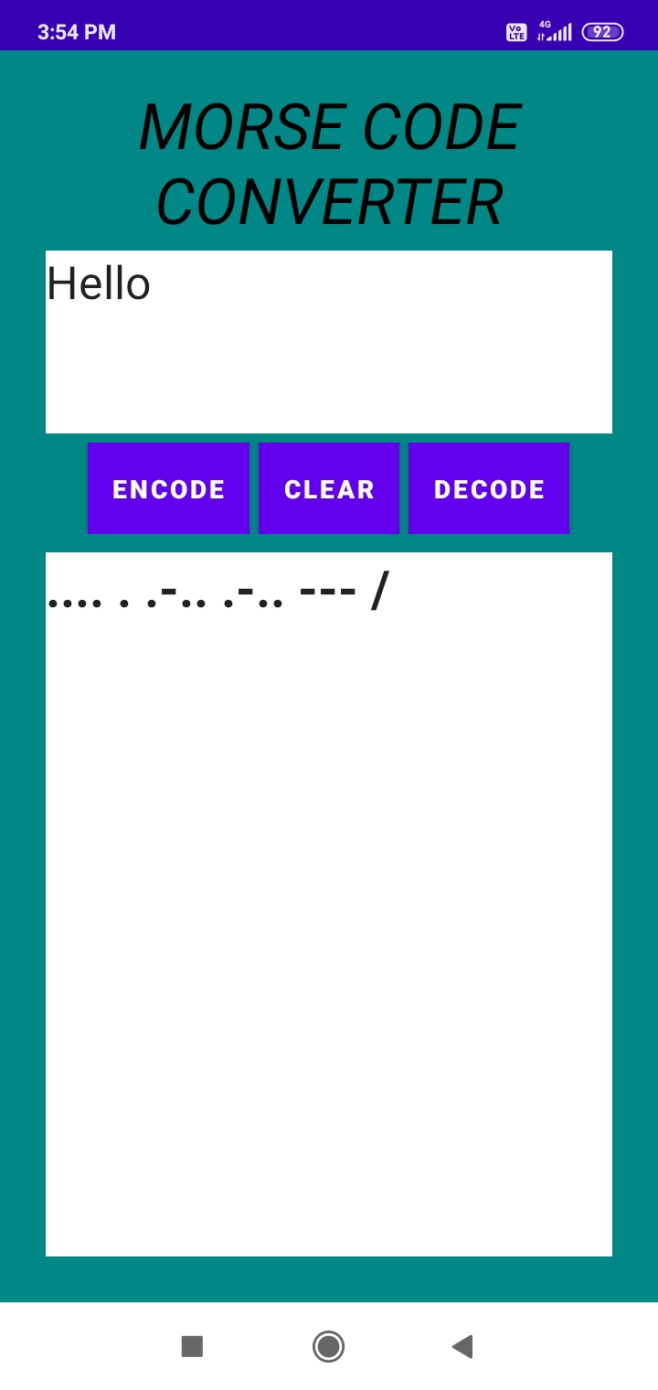
Morse Code Converter Activity
-> In this user can enter any message into it after converted we get a coded message which is morse language encoding, we can decode using same.

Slide 9
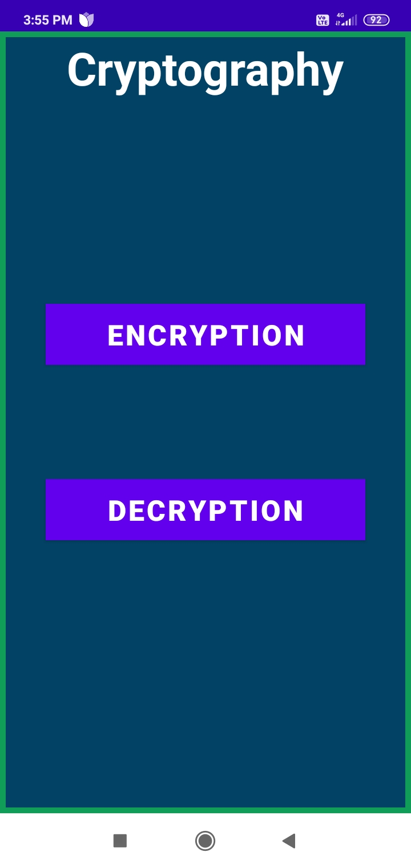
Cryptography -Activity
-> This is the home page of this feature where user get 2 option either to encrypt the message or to decrypt the already encoded message.

Slide 10
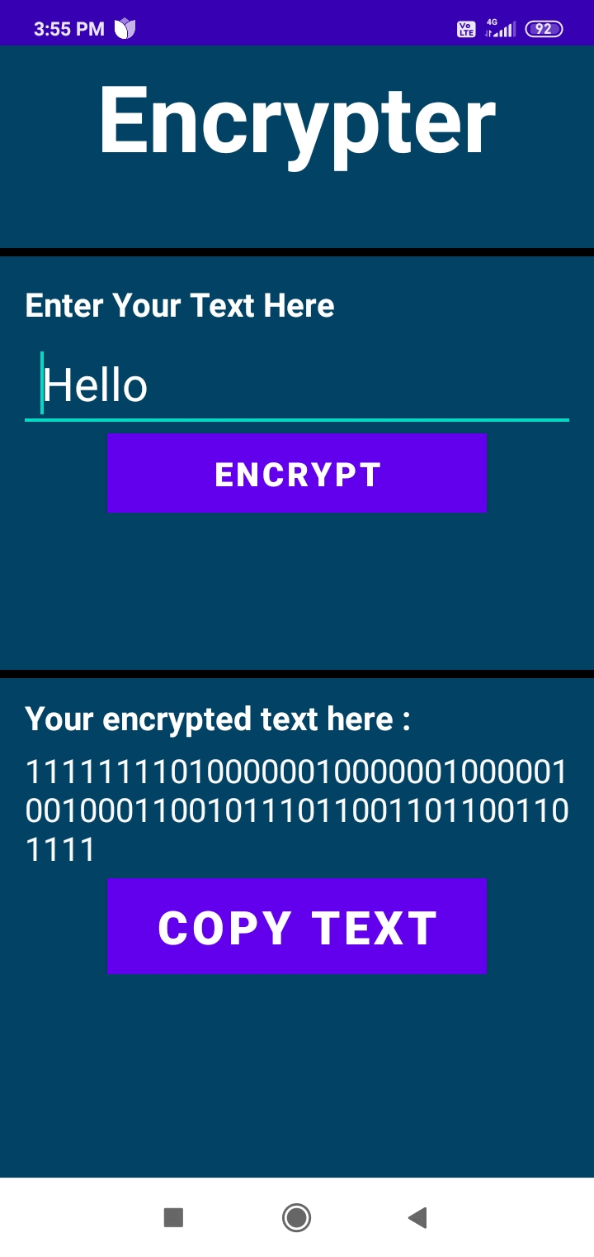
Encryption - Activity
-> This is the encryption activity where user can encrypt the message which he/she want to and can copy the equivalent encrypted message, this encrypted message can only be decrypted using same app.

Slide 11
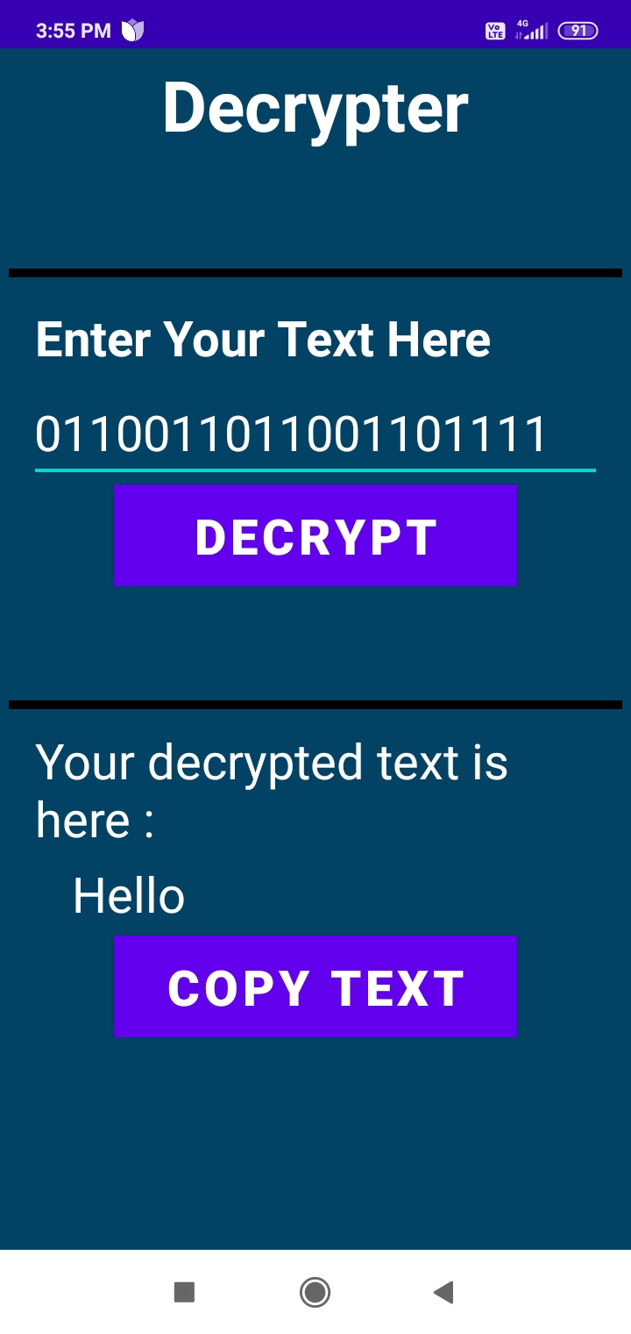
Decryption - Activity
-> This is the activity where user enter the earlier encoded message and get result as the original message.

Slide 12
(Multi Application - Project)
Presented to you by:
* Tanish Gupta (1817454)

